Slide 1
Ontologies ‘101’ - M. Balduccini

Slide 2

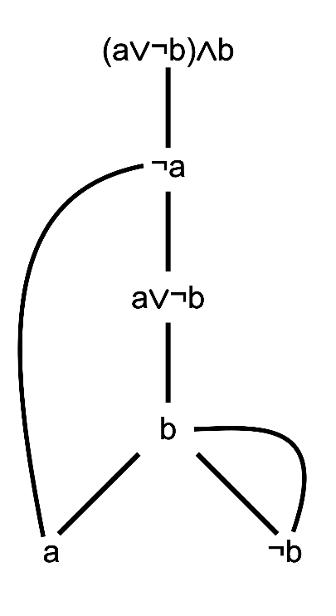

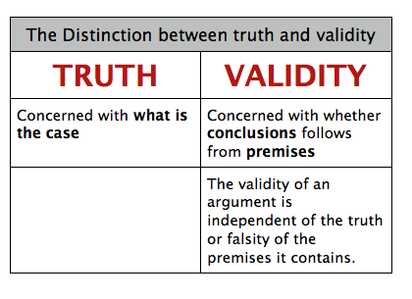
Ontologies: What They Are
A model/conceptualization of a domain of interest
Formal
Knowledge encoded in a formal language
Deriving new knowledge: precisely defined

Slide 3
Ontologies: Main Components
Computer
Classes
Sets/Categories of objects of interest
Objects/Individuals
Elements of a class
Specific, concrete objects of the domain
Relations/Properties/Attributes
Define what objects are like
Relationships between objects
Properties/attributes of an object
Axioms
Establish links between properties
subclass
subclass
Laptop
Mainframe
subclass
subclass
Gaming Laptop
Office Laptop

Slide 4
Ontologies: Main Components
Computer
Classes
Sets/Categories of objects of interest
Objects/Individuals
Elements of a class
Specific, concrete objects of the domain
Relations/Properties/Attributes
Define what objects are like
Relationships between objects
Properties/attributes of an object
Axioms
Establish links between properties
subclass
subclass
Laptop
Mainframe
subclass
subclass
Gaming Laptop
Office Laptop
is-a
is-a
John’s Laptop
SJU’s Server s01

Slide 5
Ontologies: Main Components
Computer
Classes
Sets/Categories of objects of interest
Objects/Individuals
Elements of a class
Specific, concrete objects of the domain
Relations/Properties/Attributes
Define what objects are like
Relationships between objects
Properties/attributes of an object
Axioms
Establish links between properties
subclass
subclass
Laptop
Mainframe
subclass
subclass
Gaming Laptop
Office Laptop
is-a
is-a
John’s Laptop
SJU’s Server s01
RAM-amount-GB
authenticates-to
has-OS
Windows Server 2012
8
affects
10.0
CVSS-score
CVE-2012-2897

Slide 6
Ontologies: Main Components
Computer
Classes
Sets/Categories of objects of interest
Objects/Individuals
Elements of a class
Specific, concrete objects of the domain
Relations/Properties/Attributes
Define what objects are like
Relationships between objects
Properties/attributes of an object
Axioms
Establish links between properties
subclass
subclass
Laptop
Mainframe
subclass
subclass
Gaming Laptop
Office Laptop
is-a
is-a
John’s Laptop
SJU’s Server s01
RAM-amount-GB
authenticates-to
has-OS
Windows Server 2012
8
affects
10.0
CVSS-score
CVE-2012-2897
“If PC has-OS OS and X affects OS, then X affects PC”

Slide 7
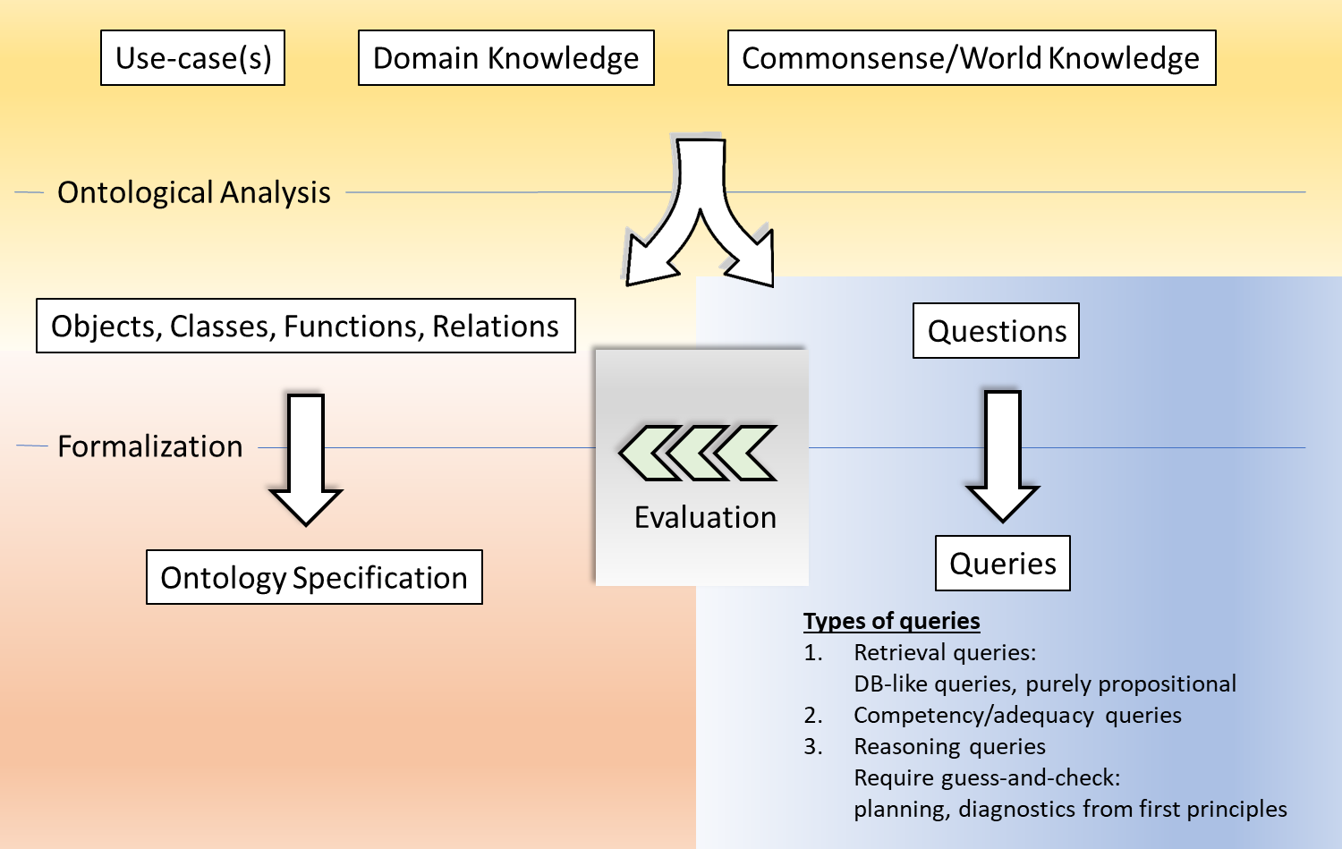
Modeling Methodology: Conceptual Ontology

Slide 8
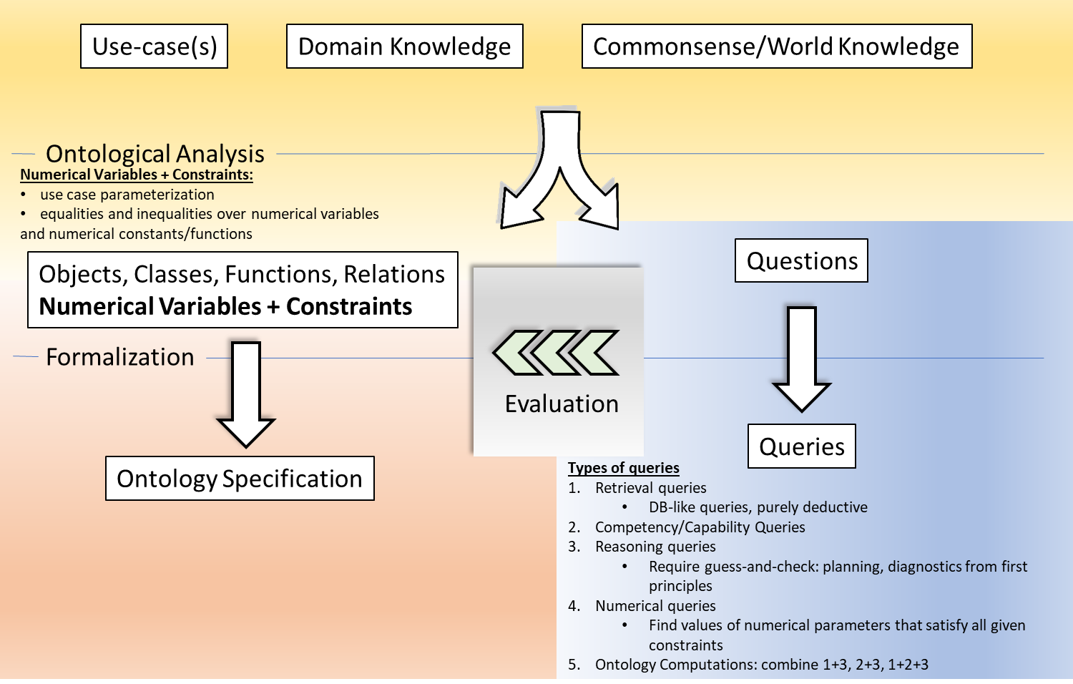
Modeling Methodology: Parametrization, Ontology Calculus

Slide 9
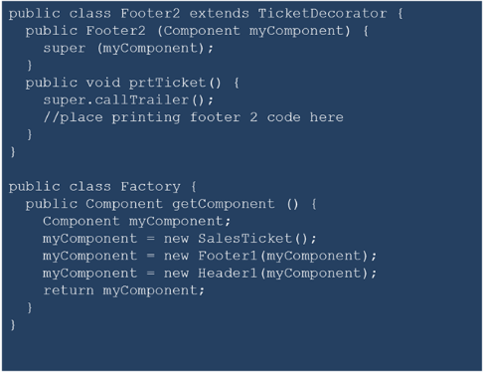
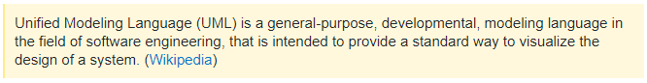
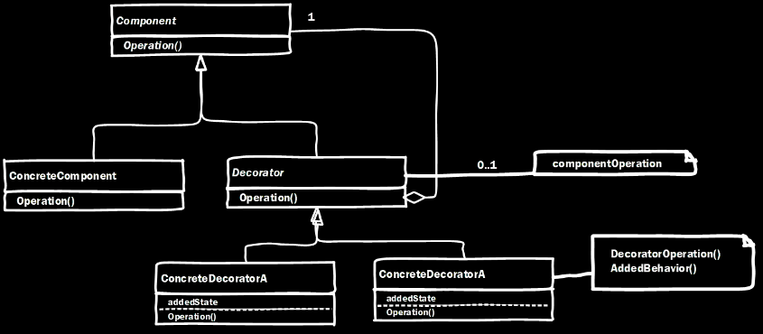
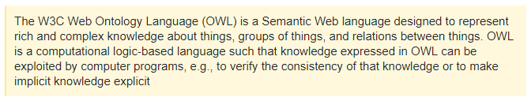
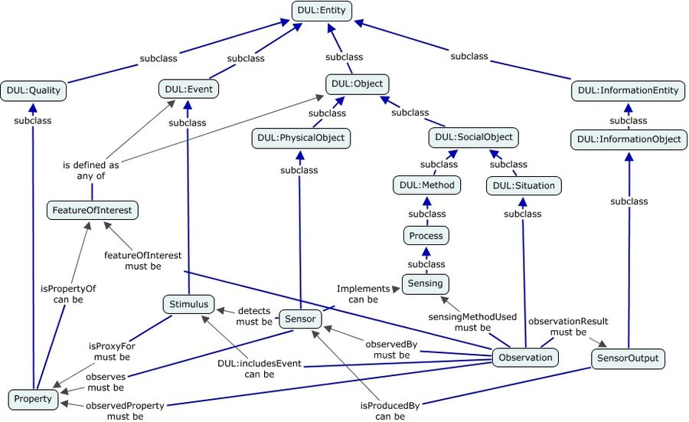
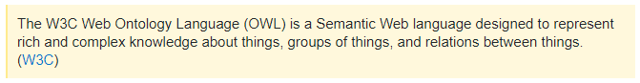
Modeling Tools
UML
Focus: systems, system design, code generation
Knowledge Representation (KR) Languages, OWL
Focus: “world” knowledge, commonsense, automated reasoning

Slide 10
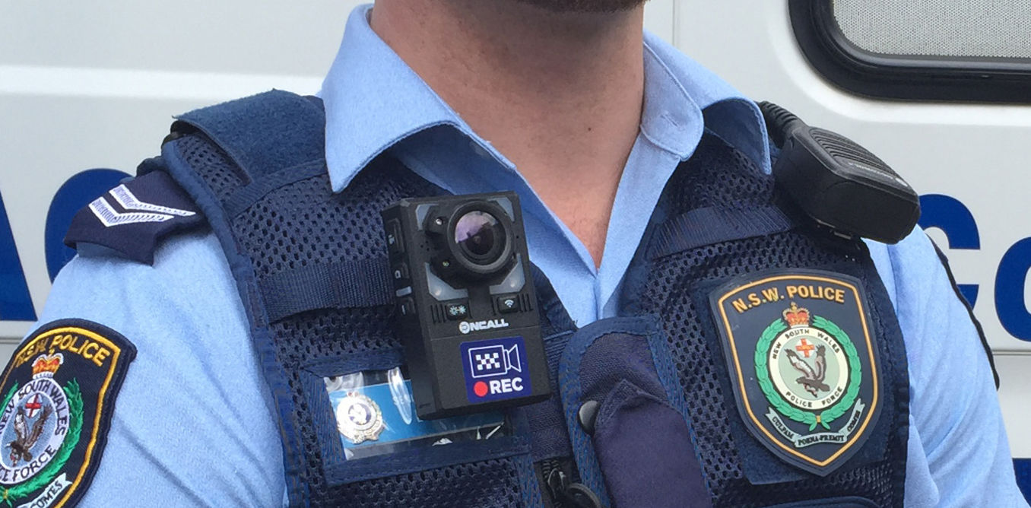
Modeling Use-Case
Device
model
Police body cameras
Body cameras, location sensors, alarm sirens
Security
Physical Security: broken, stolen
Cyber Security: CIA of data streams
Important if used in court
Potential approach: timestamp
Privacy
Is face recognition in use?
Who has access to the information?
Reliability: will the camera work 24/7?
Data reliability:
Multiple cameras, multiple streams
Stored on a server
Who has access? Who can access all streams?
Resilience
What if a camera does not work?
Can the stream from a nearby camera be used as a substitute?
“Stitch camera feeds from home security systems”
Trustworthiness elements

Slide 11
Earlier Work: Cone-of-Impact Vulnerability Assessment

